Slide 1


26 - AI-enhanced Smart Physical Rehabilitation
1
Computer Science: Xian Gao, Molly Meadows, Noah Rieth
Instructor: Bruce Bolden
Clients: Dr. Alexander Vakanski, Dr. Min Xian

Slide 2
Overview
2
Objective
Value Proposition
Background/Product Requirements
Conceptual Development Process
Recommendations
Risks and Mitigation
Validation
Schedule

Slide 3
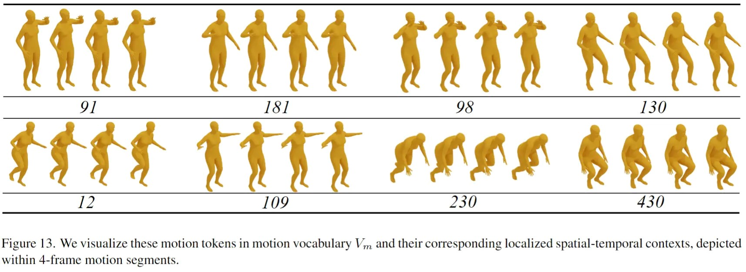
Objective
3
Develop Deep Learning System: Create a deep learning system for evaluating the correctness of physical rehabilitation exercises from smartphone-captured videos.
Video Collection and Skeletal Data Extraction: Gather exercise videos and extract skeletal data of joint movements.
Exercise Quality Assessment and Feedback: Tune motion-to-text deep learning models to assess exercise quality and provide meaningful text feedback to improve performance.

Slide 4
Value Proposition
4
Rehabilitation after injury prolonged:
No feedback on their exercises
Practicing exercises incorrectly
No progress on recovery
Can be expensive!
Create a way to give feedback given a video from user of them completing an exercise
Notes:
Rehabilitation recovery time after an injury is often prolonged due to patients incorrectly performing their physical exercises at home. Without proper real time feedback, it is difficult for patients to progress towards total recovery. And since physical therapy is so expensive, any extra time spent with physical therapists procure additional costs. Our project aims to help solve this problem by creating a deep learning model that will analyze uploaded videos by the client of them completing exercises, and then will provide detailed feedback consisting of an accuracy rating and steps to improve!

Slide 5
Background
5
Zhang – MotionGPT Finetuned LLMs
This MotionGPT project is concerned with the generation of human motion from multimodal inputs.
Using initial and or intermediate poses in addition to text in an LLM prompt instruction could have useful applications
This project demonstrates that accurate and diverse human motions can be generated by a model with >99% similarity to a LLM

Slide 6
Background
6
Jiang – Human Motion as a Foreign Language
MotionGPT treats human motion as a foreign language, learning its grammar and syntax. It's pre-trained on motion-language data, excelling in tasks like text-to-motion, motion-to-text, motion prediction, and motion in-between, showcasing its ability to connect human motion and language effectively.

Slide 7
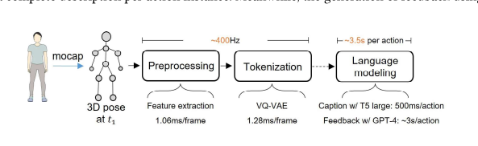
Background
7
Wang – Ubiphysio
Uses an IMU motion capture suit and multiple cameras to obtain data of movements
After it captures the skeletal data, the team then normalizes the data onto the z axis using skeletal normalization
Feedback generation
Query a knowledge database based on an action recognized by the model to generate responses

Slide 8
Product Requirements
8
At least one exercise
Numerical accuracy rating (1-10)
Meaningful written feedback
Ex. "For the deep squat exercise, try straightening your back for increased accuracy"
Must be able to analyze a video taken from a smart phone
Must be able to provide feedback in a reasonable amount of time
Project should analyze at least 100 human skeletal movements

Slide 9
Concept Design Plan Overview
9
Initial plans
Current Design Plan
Risks and Mitigation

Slide 10
Initial Plan Ideas: Build Model From Scratch
10
Build a python machine learning model from scratch
Modeled after using a sklearn database:
X_test: independent variables (% of database used to test the model )
X_train: independent variables (% of database used to train the model)
Y_train: dependent variable generated by the model to be tested against (label)
Y_test: labels for the test data (compare labels from train to test to see accuracy)
Use a deep neural network or a convolutional neural network to train the model
Output results to the console
Use our own training model to categorize which exercise was input
Compare the input video to other videos in database (x_train, x_test, y_train, y_test)
Output an accuracy rating and meaningful feedback to the console
Extract skeletal data

Slide 11
Pros and Cons of Initial Plan
11
Pros
Cons
Can create model to do exactly what we want it to
No extra information and unrelated scripts from other projects
More intuitive to start
Building the database would take a lot of time
Manually label test cases for accuracy
Multiple rounds of training
Which exercise label
Generate quality score
Still have to somehow integrate with a LLM to generate text output

Slide 12
Skeletal Extraction Libraries
12
PoseFormerV2 and VideoPose3D
BlazePose
OpenPose
PoseFormerV2
2D joint detection using spatial and temporal neural networks
VideoPose3D
3D joint detection using temporal convolutions
It can accurately track 33 key points on the human body, enabling real-time estimation of human posture and movements.
Specializes in detecting the skeletal points of multiple people in one frame
Notes:
"Each student can implement a different library for pose estimation, which can be used for comparing the results and evaluating the different pose estimation methods "

Slide 13

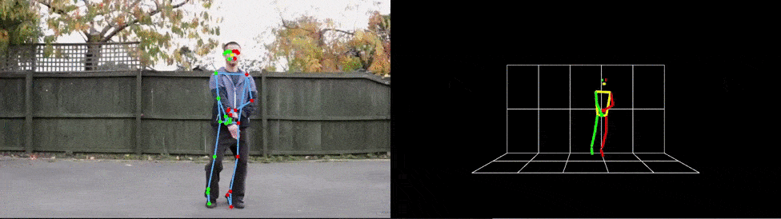
BlazePose
13
BlazePose is can be used on the DepthAI, I have download the DepthAI ,then I am trying to figure out how to used it on my pc. This is a practical demonstration of BlazePose.

Slide 14
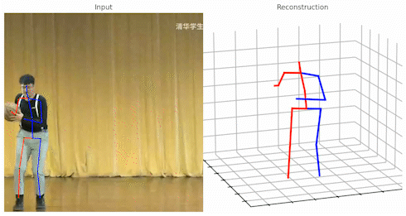
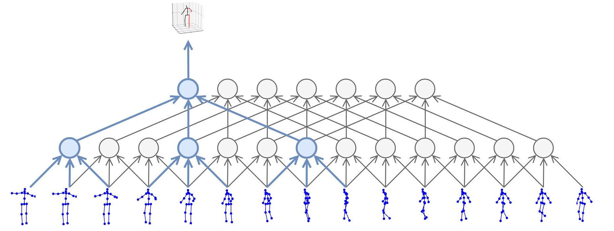
PoseFormerV2 and VideoPose3D
14
Both PoseFormerV2 and VideoPose3D rely on models build from the Human 3.6M dataset
I have requested access to the models but the admins must approve my request
Since there is no contact information on the website I don't know when or if I can access these models

Slide 15
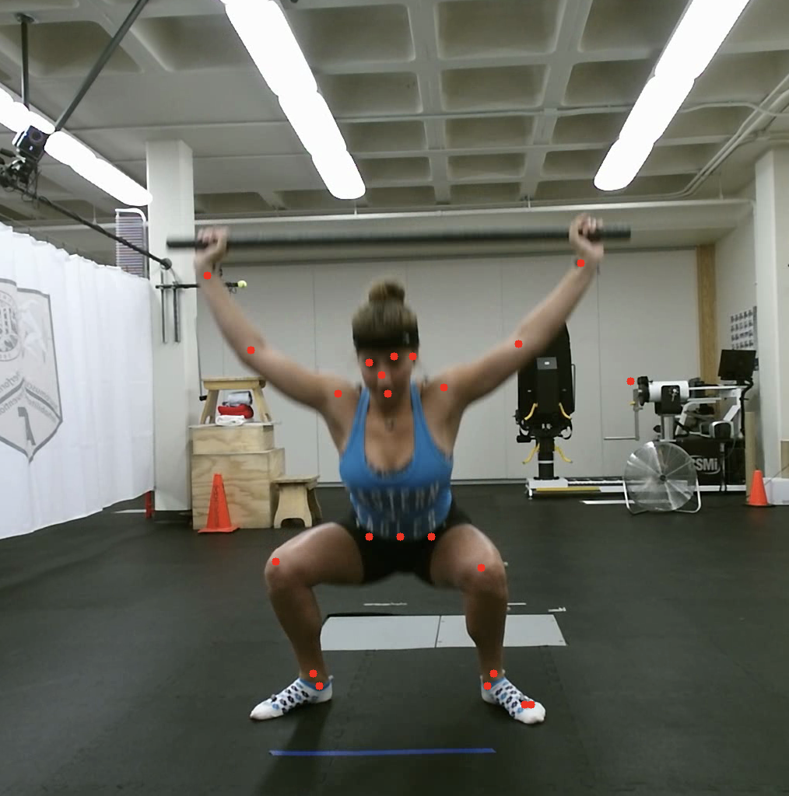
OpenPose
15
Currently using OpenPose for the project
OpenPose has several available models that work in this context
Body 25, COCO, MPI

Slide 16
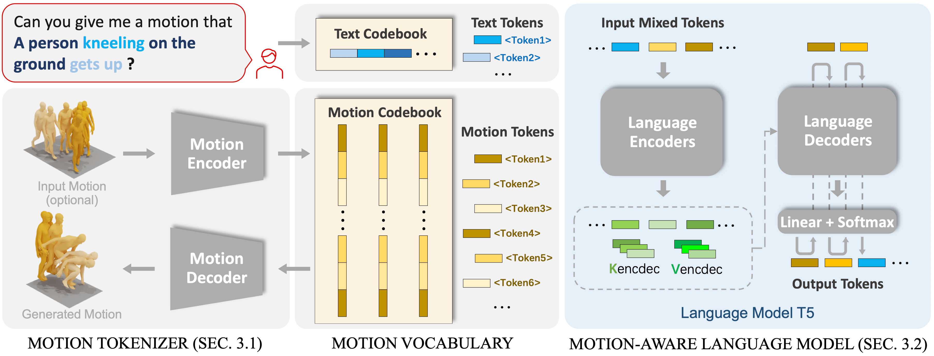
What is MotionGPT?
16
Motion-language model
Fuses language data and motion models
Utilizes prompt-learning
Motion to text
Text to Motion

Slide 17
Motion GPT Demo
17
https://huggingface.co/spaces/OpenMotionLab/MotionGPT

Slide 18
Official Design Plan
18
Process the tokens to recognize movements and give feedback to the console by using MotionGPT
Apply Data Preprocessing
Tokenize the motions using MotionGPT tokenizing system
Extract skeletal data
Collect more data for other exercises

Slide 19
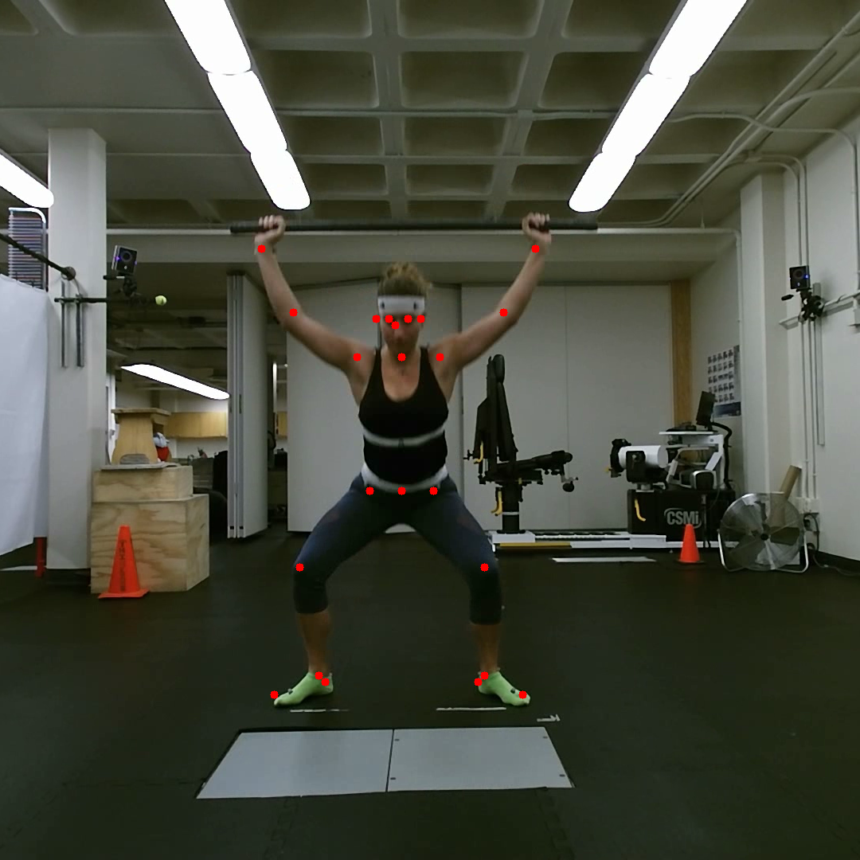
Skeletal Extraction
19
OpenPose
Using a python script to analyze video frame by frame
Store into an image array and converted to an .avi file
25 mapping keypoints (1 point is for background)
1stDeepSquat.avi

Slide 20
Data Preprocessing
20
Data preprocessing is a common step in machine learning tasks, where raw data is transformed and cleaned to make it suitable for model training.
Our model will require the locations of particular joints for every frame of motion that is being analyzed, and Skeletal joint extraction will not always be able to generate joint locations with enough confidence.
Simulate missing joint locations
All of the skeletal data must be normalized in scale and direction to make training easier
The relative distances between joints must be the same across data samples and across different frames of the same data sample
Skeletons must be consistently oriented so that similar motions and poses can be recognized
The positions must be centered uniformly across samples.

Slide 21
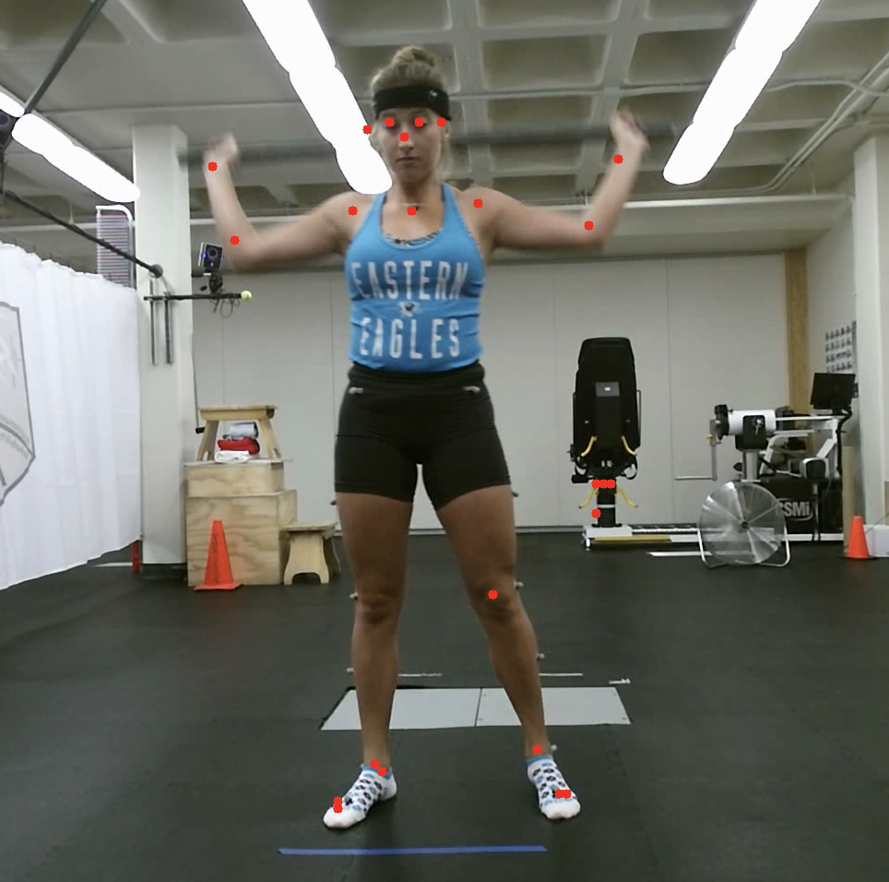
Data Preprocessing
21

Slide 22
Tokenize The Motions
22
Use Motion GPT
To tokenize motions, MotionGPT uses a pre-trained 3D human motion tokenizer V based on the Vector Quantized Variational Autoencoders (VQ-VAE) architecture. The motion codebook is used to represent human motion as discrete tokens .
Apply VQ-VAE model
MotionGPT applies a motion-specific Vector Quantized Variational Autoencoder (VQ-VAE) model to construct a "motion vocabulary" and convert raw motion data into a sequence of motion tokens .

Slide 23
Process Movements and Give Feedback
23
Use Motion GPT
By recursively analyzing the sequence of tokens given to the model by the user, MotionGPT will generate the most likely target sequence (text or motion) during model training
Motion GPT has a combined codebook of text and motion target "words"
This method captures the patterns for each motion which we can use to generate feedback
Motion-to-text: use this to give written feedback to the user
Motion to text generates texts that describes the motion fed into the model
Ex. "To enhance your performance, try straightening your back"
Motion prediction tasks: provide an accuracy rating given a score
Ex. "Deep Squat Accuracy: 9/10"

Slide 24
Risks and Mitigation
24
If OpenPose output does not tokenize well with the VQ-VAE model, we can attempt to use an alternative skeletal joint extraction library
BlazePose
Model processing time
Lighter weight Skeletal Extraction Model
Running the model on multiple GPU servers
If we cannot find a script to preprocess the skeletal data
Create a new one from scratch

Slide 25
Schedule
25
GanttChart

Slide 26
Design Validation
26
Design Validation

Slide 27

Questions or Feedback
27

